Slide 1
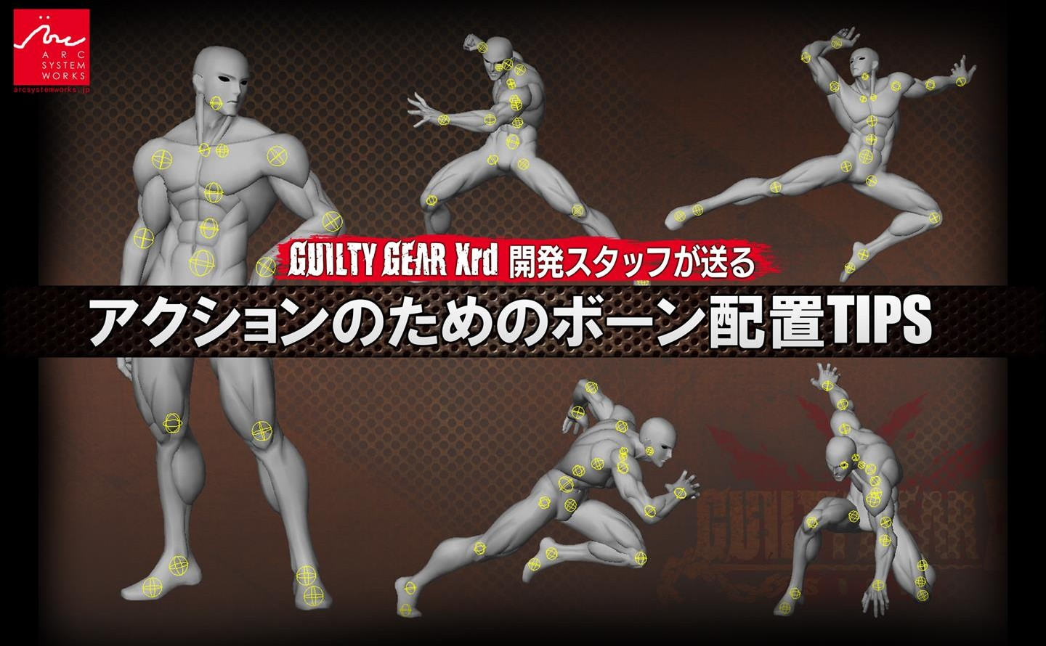
Development Staff
Bone Placement Tips for Action
Translated by @LeoBGKK via DeepL, Yandex.Translate.

Slide 2
About today’s talk

Slide 3
OUTLINE
Proposition: If you're having trouble striking a cool pose, it's probably because you're not placing the bones properly!
When creating a character model, the mesh shape looks good and the skinning is fine, but when it comes time to pose an action, it just doesn't look quite right. Have you ever had that happen? This may be because the joint bone positions are not set properly.
In this lecture, I will talk about the know-how I have acquired through the production of fighting games.
These are some practical examples of bone placement that can withstand extreme actions.
Intended Audience: If you can make a mesh, but feel that it is not complete when posed. / People who want to create a more versatile character model.

Slide 4

Speaker Profile
Junya Christopher Motomura
Arc System Works Co.
Lead Modeler / Technical Artist / Various others
I was a modeler and wanted to write shaders, so I became a technical artist.
Modeling, rigging, shader creation, giving talks, etc. Currently in charge of technical art support and R&D.
Representative Works
⇒GUILTY GEAR Xrd Series
Lead Modeler / Technical Artist
⇒DRAGON BALL FighterZ (Bandai Namco Entertainment)
Director / Modeling Supervisor / Technical Artist

Slide 5
Table of Contents
PART1: Why bone placement is important
PART2: Bone placement in various body parts
common mistakes and guidelines
⇒Bone placement in the lower half of the body
Base of foot ・ Knee ・ Ankle ・ Base of toe
⇒Bone placement in the torso
Center of gravity ・Spine ・Pelvis
⇒Bone placement in the upper body
Clavicle・Base of Upper Arm・Elbows, Wrists and Fingers・Neck and Head
PART3: How to find the right bone placement

Slide 6
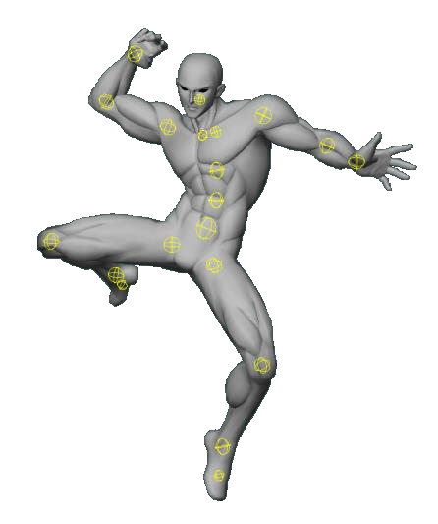
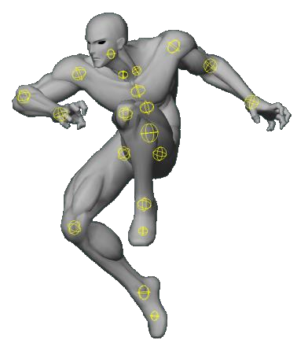
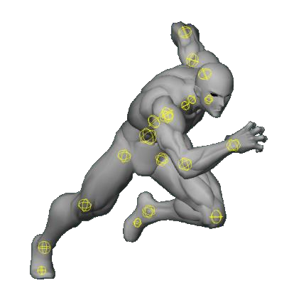
First.
Versatile Bone placement to handle the action of fighting games.
In this seminar, we will discuss how to use bone placement to support the flashy attacks and poses of fighting games.
Here are some ideas.
Fighting games require the human body to be depicted in flashy actions and emphasized poses, sometimes more exaggerated than in reality. If the rig can handle fighting games, it will be able to handle a variety of situations, from everyday animations to detailed performances.
It's not necessarily anatomically correct.
In order to accurately reproduce the behavior of the human body (the muscles, skin, fat, ligaments, etc.), it is necessary to simulate the deformation. This is not possible in a real time game, so to some extent you have to play around with it.
The bone layout presented here is not an exact reproduction of the actual human body structure, but rather a set of exaggerations and omissions that have been made to suit the convenience of real-time animation.
In the end, my stance is, “As long as what you see on the screen is cool, it's OK”.

Slide 7
Why choose “Bone Placement” as a topic?
⇒It's inconspicuous, but it's directly related to the final quality, and it's quite literally the root of everything.
Unlike mesh geometry and skinning deformation results, it's hard to judge the quality of bone placement at a glance.
But it’s a factor that in some ways has a more serious impact than skinning in terms of ideal animation and posing.
A lacking bone position cannot be corrected by adjusting the skinning.
⇒Very difficult to modify afterwards
What makes bone placement even more important is the difficulty of correcting it afterwards. If you do find a bad bone placement and try to fix it, it is possible that 100 animations have already been created with that bone placement.
In such a case, 100 animations would have to be modified, checked, and exported again to accommodate the change in bone position.
The larger the project, the harder it’ll be to fix, and the more likely it is that a case will come up where you won’t be able to. Therefore, it’s necessary to carefully examine and decide on the bone placement in the early stages to avoid mistakes.
⇒Lack of clear Guidelines and Study Materials
As you can see, bone placement is very important, but there aren’t many books in the world on 3DCG about how to place bones.
As far as I know, there is no clear document or guideline. In most cases, individual artists refer to anatomical drawings of the human body and use their senses and experience to make their own arrangements.
In this seminar, I would like to introduce a guideline of bone placement that is likely to work well based on the knowledge I have accumulated so far.

Slide 8
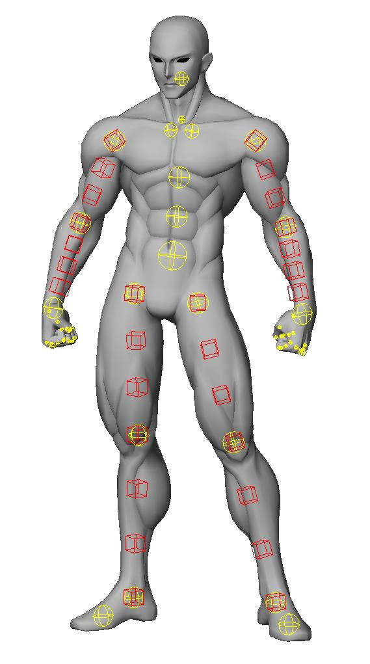
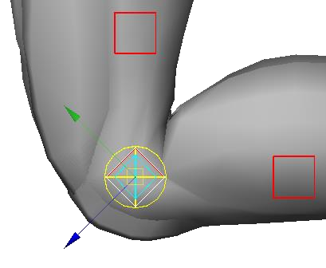

Introduction of Sample Models
A simple rig for illustration purposes.
Simple poseable doll-like rig structure based on FK
The limbs have auxiliary bones to guide twisting.
Shoulders, elbows, wrists, base of feet, knees, and ankles have semi-rotating auxiliary bones.
He's got a hero's physique that looks great in action, but...
The model is "for action" and has a hero's body shape with broad shoulders for flashy poses. However, the bone placement that will be introduced in this seminar is something that can be applied to any characters with body shapes other than the “hero” body shape, such as women and children.
Supplemental information about the half-turn auxiliary bone.
In the character's rig, it is useful to place auxiliary bones that follow each joint with 50% rotation.
As an example, when you bend your knee 90º, for example, the auxiliary bone points to a 45º angle.
If you have one, it is sometimes easier to represent a "kneecap".

Slide 9
Part１
Why is bone placement so important?

Slide 10
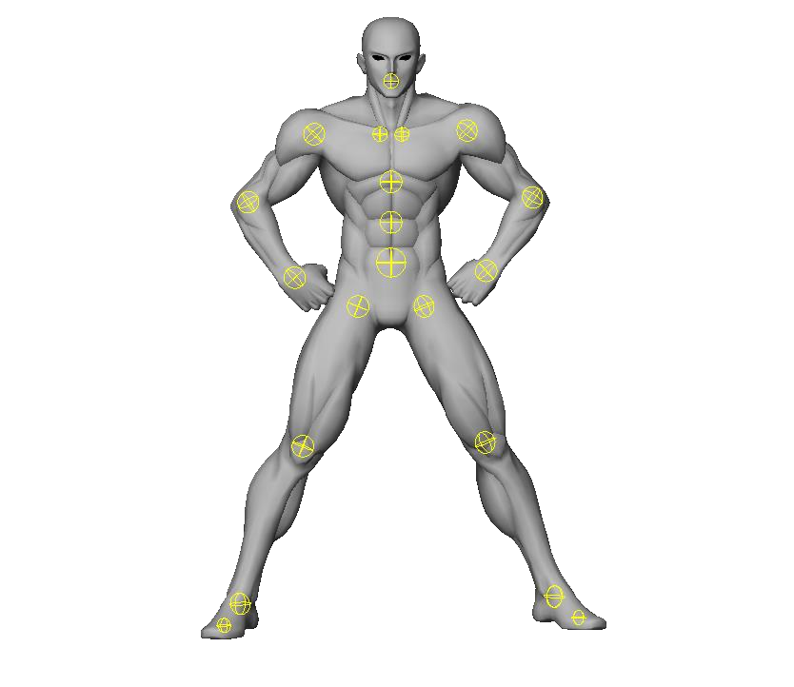
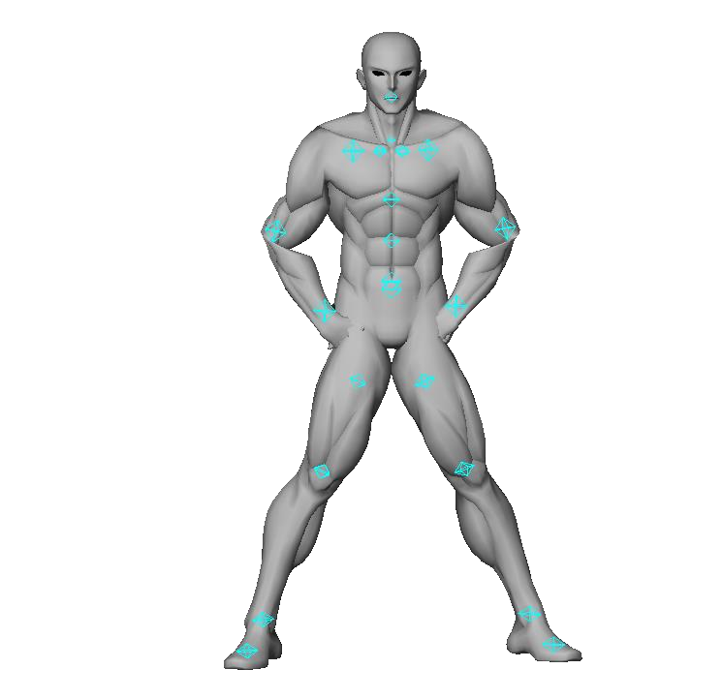
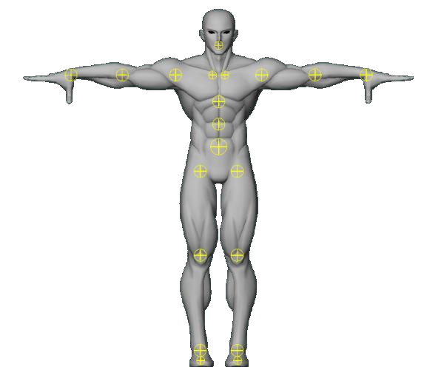
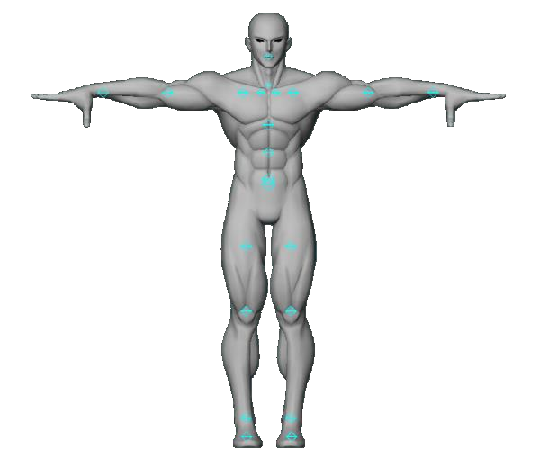
First, an extreme example
This is an extreme example, but even with the same T-pose, the feeling of the pose can change so much with different bone placement.
In reality, if the discrepancy is this extreme, the mistake will be noticed and corrected.
But if it’s too small to be immediately noticed, it will be overlooked and will eventually lead to an unconscious feeling of discomfort, that “something is wrong” or “this is low quality”.

Slide 11
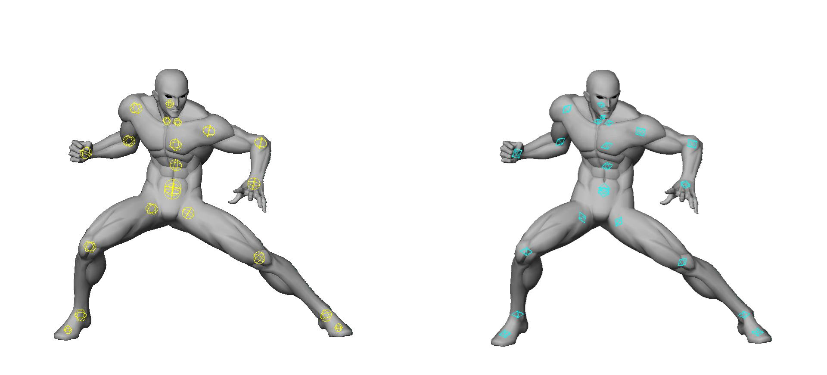
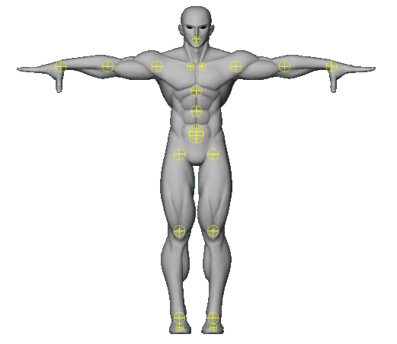
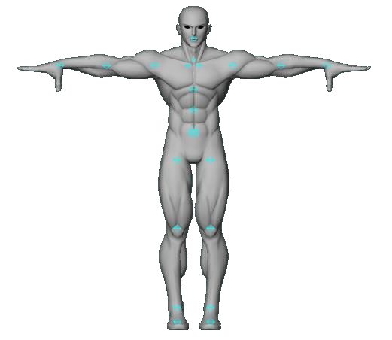
Examples of slight distortion due to bone positions
Although not as extreme as the previous page, here is a practical example.
The left and right sides of the figure below have the same mesh and differ only in the height of the bone placement at the base of the thigh/groin.
It's a subtle difference, but which pose looks more dynamic, the right or the left?

Slide 12
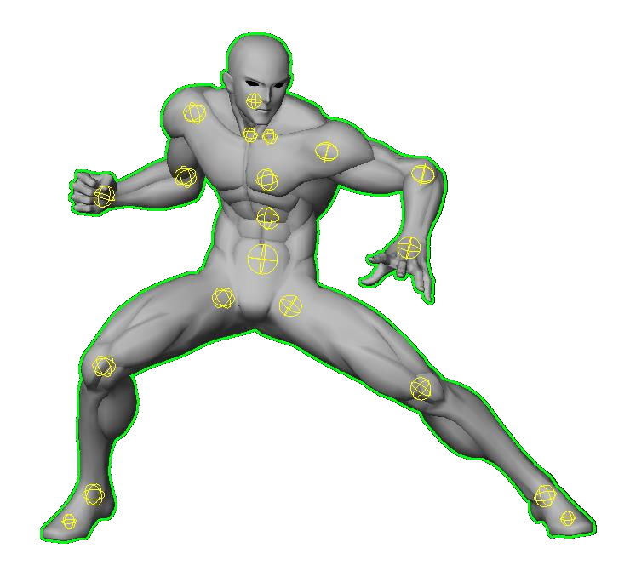
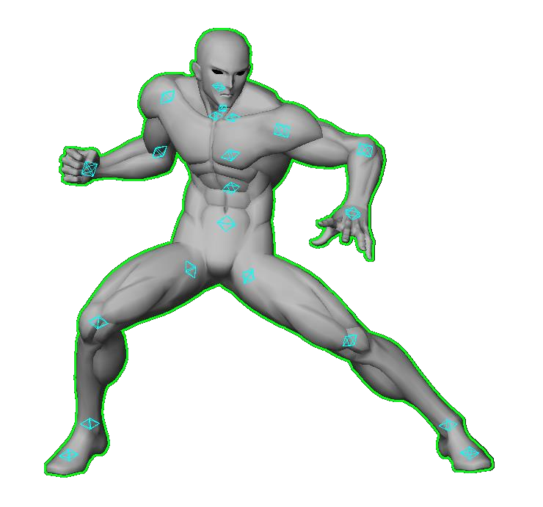
Examples of slight distortion due to bone positions
Let's outline it for clarity. Notice the length of the legs and the look of the silhouette between the legs.
Can you see how the different bone positions reshape the waist and make the pose slightly shrunken?

Slide 13
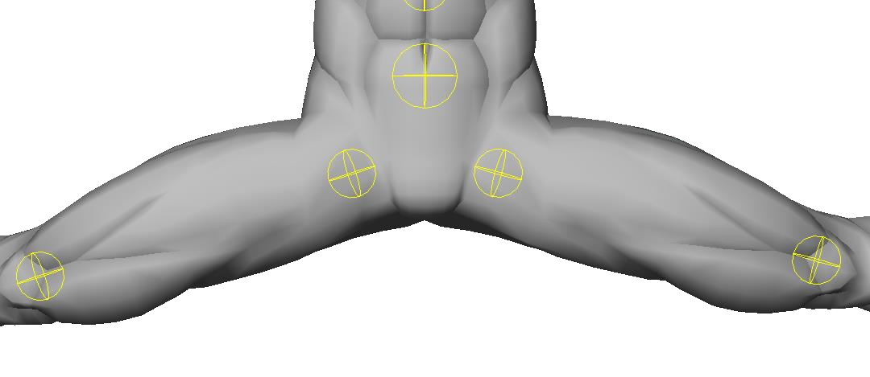
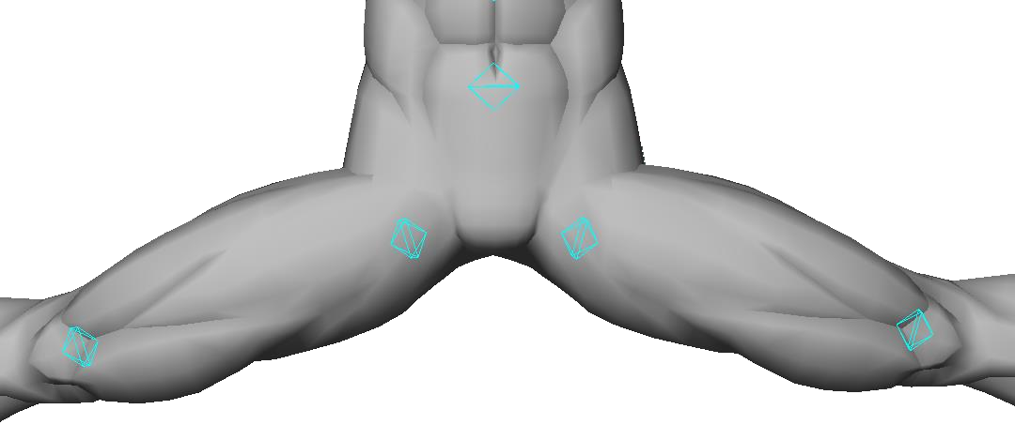
Extreme poses reveal mistakes.
The issue is more noticeable when more extreme poses are performed.
The inadequacy of the bone position is apparent when the legs are opened wide for kicking techniques.
In this example, the silhouette when the legs are open is wrong in the right example because the position of the hip rotation axis is different.
As you can see, the bigger the action, the more apparent the inadequacy of the bone position becomes.
Unless you intentionally check in extreme poses, it can easily be overlooked.
In order to avoid this, it is important to know the correct bone placement guidelines in advance.

Slide 14
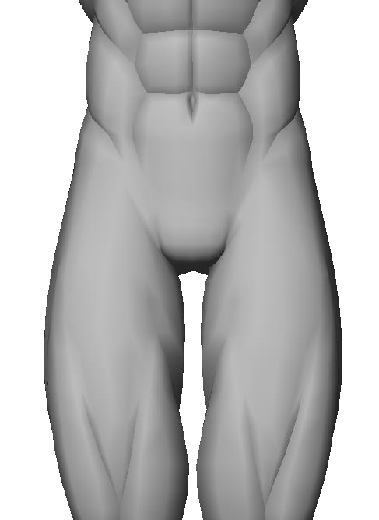






Common Mistake: Placing bones based on preconceived notions.
One of the most common things we tend to do while inexperienced is to place joints based on our assumptions.
My preconceived notion places the joint at the "root of the leg”.
If you rotate from there, there will be "too much inside of the leg.”
As a result, we end up with a distorted deformation result as shown earlier.
In order to obtain the desired deformation results, it is necessary to think of an arrangement, after carefully studying the structure, and without relying on assumptions.

Slide 15

Summary: Why bone placement is so important.
⇒If the bones are not in the correct position, the joints will not bend properly. Naturally, posing is also adversely affected.
⇒The more extreme the action pose, the greater the impact.
⇒Defects in bone position are less likely to be exposed.
It is only when you actually strike an extreme pose that the problems are shown.
And in many cases, by the time you realize it, it's already too late.
⇒Know the appropriate bone position and set it in advance.
It is super important. And be sure to check it before proceeding with the animation work!

Slide 16
Part２
Bone Placement of Each Body Part
Common Mistakes and Guidelines

Slide 17
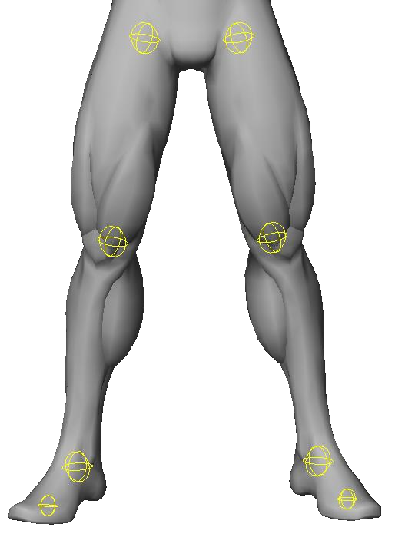
Lower Body

Slide 18
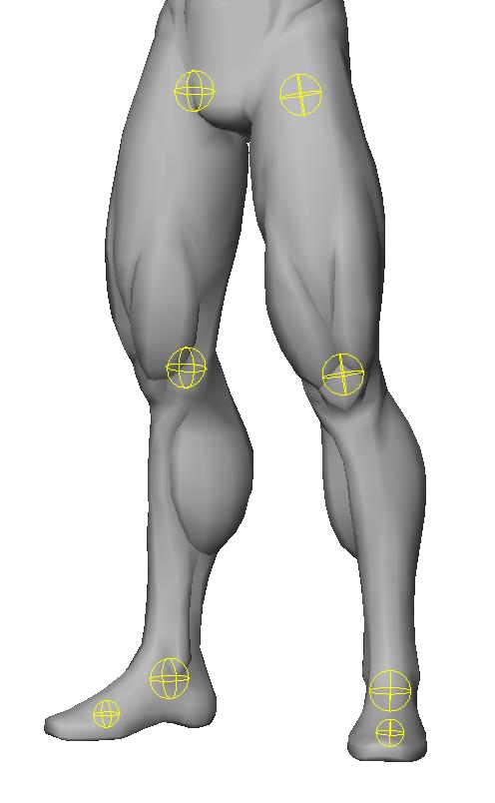
Starting with the Lower Body.
⇒The lower body, the foundation of the entire body, is extremely important in action.
The first thing that needs to be checked when placing bones is the lower body.
This is because it accounts for the majority of the figure of the entire body, and is the area where the silhouette shows the very foundation of all actions, such as shifting the center of gravity and stepping.
Also, as the rig tends to be complex, with IK settings for ground contact, adjusting the animation afterwards is more difficult than with the upper body, and tends to require more man-hours.
When placing bones, it is important to master the placement of the lower body first and foremost, as this will improve efficiency later on.

Slide 19
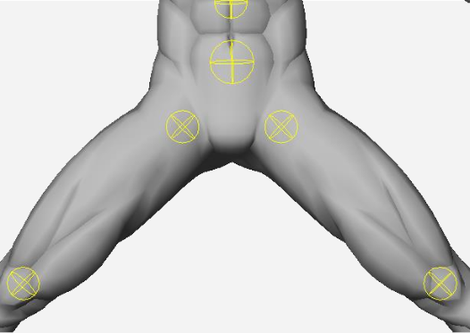
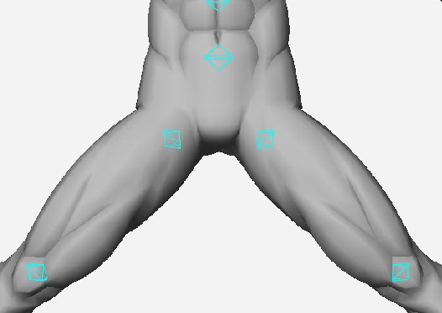

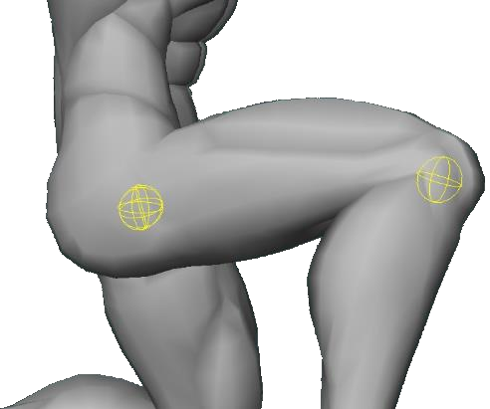
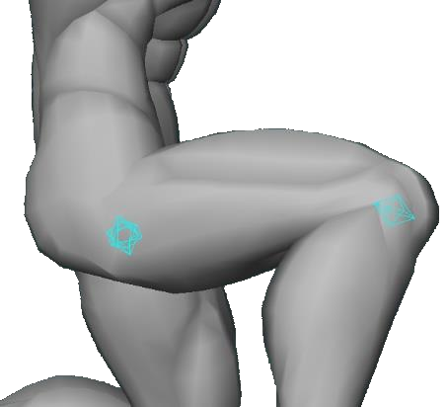

Common Mistake: Low hip position.
As I already mentioned earlier, hip placement mistakes are easy to make because they have a large impact and are hard to see unless you are in an extreme pose. A common mistake is to place the axis of rotation in a very low position.
Because of the difference in the axis of rotation, the shape of the legs when they are opened dynamically is very different.
It is important to note that the waist can be stretched out, making the torso look relatively long and the legs short.
The shape of the buttocks from the side is also very distorted, making the hips and legs look as if they are not properly connected.

Slide 20
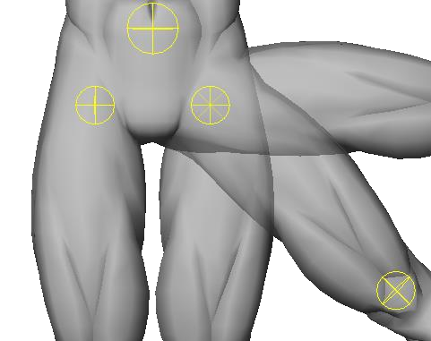
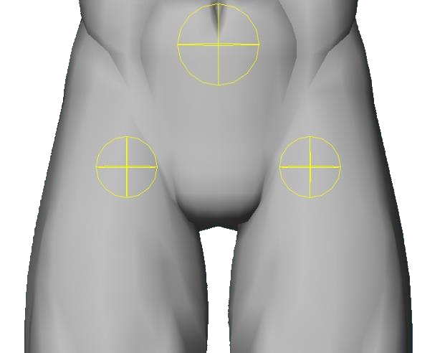

Guideline: Hip joint placement (Front)
⇒Concept
When placing joints, it is easier to think backwards from the range of motion. The human hip joint can be rotated approximately 90 degrees from the bottom to the side. (ie.: Doing the splits.)
So, you can figure out the placement where both the maximum angle opening and the lowered angle are valid.
⇒Approximate placement
From the base of the groin.
Draw a 45º line diagonally upward and place where it intersects the line at the center of your foot.
This is much less likely to fail.
Anatomically, it should not be that far off from the actual human body.

Slide 21
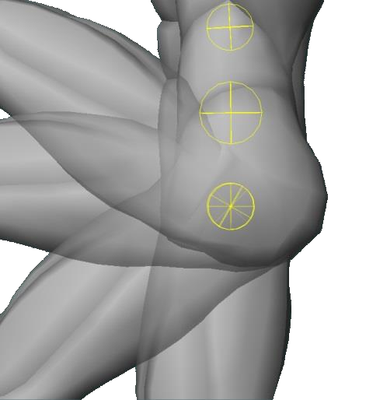
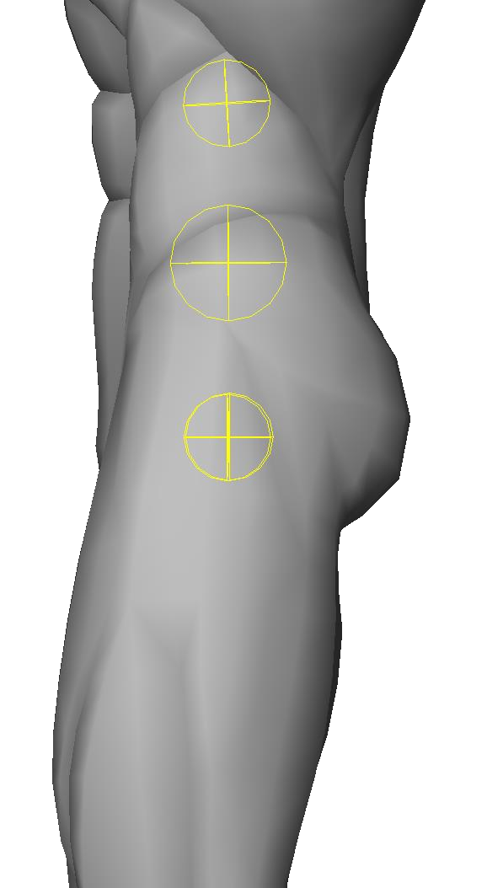

Guideline: Hip joint placement (Side)
⇒Concept
The same basic concept applies to the view from the side.
The legs can be bent forward more than 90º, so when considering the full waist, the placement should be slightly forward.
⇒Approximate placement
The best results are often obtained by placing it at the approximate center of the remaining thickness, based on the width of the entire hips from front to back, excluding the overhang of the buttocks.
Since humans were once quadrupeds, it’s a good idea to remember that "The legs are conveniently designed to bend forward."

Slide 22
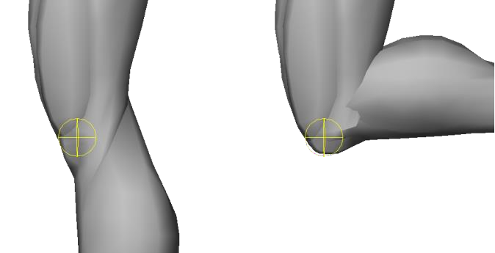
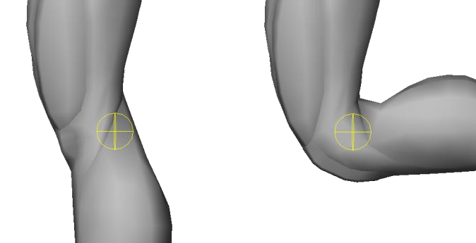


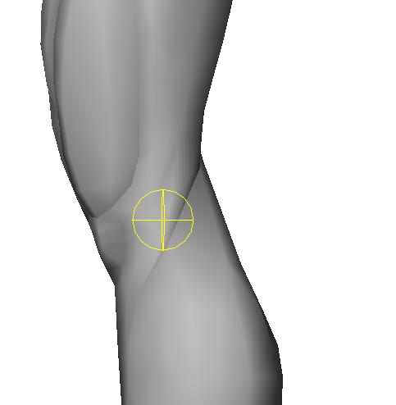
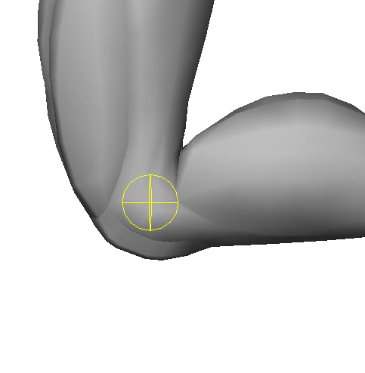
Guideline: Knee joint placement
The knee joint bends only in one direction, and since we often see it bending in walk cycles, it’s the part of the body where mistakes are less likely to occur. However, if you are not careful, the result of deformation when you bend the knee severely can be an unappealing shape.
If the joint position is too far forward, the kneecap becomes the pivot. The calf is clipping in.
If the joint position is too far back, the knee stretches and makes the whole thing look thin.
⇒Approximate placement
The knee joint can simply be thought of as the center of the front-to-back width of the knee.

Slide 23
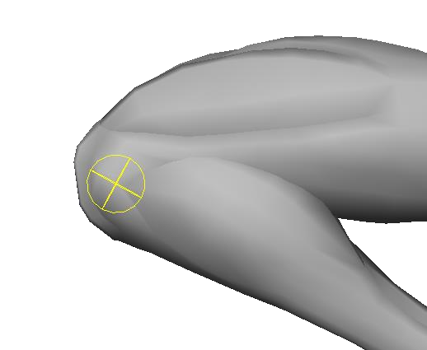
Appendix: Shape aids for the knee joint
The knee joint is one of the most conspicuous joints because it faces forward. Furthermore, the structure around the knee joint of the human body is so complex that it cannot be expressed by a simple single-axis joint.
The help of some kind of auxiliary bone is needed to express the shape of the knee well, especially when the knee is bent deeply, such as during a knee kick.
⇒ Auxiliary bones to represent "knee plates".
In the actual human body, the knee is a double joint where the femur and tibia slide and rotate against each other.
It is very close. In addition, there is the "kneecap" element, which is inherently a very complex structure.
Due to the limited number of bones and the complexity of the structure, it's hard to reproduce all of it, but there is a big difference in expressiveness between having auxiliary bones to reproduce the shape when the legs are deeply bent and not having them.
In this example, the auxiliary bone that performs the "half rotation", mentioned earlier is placed on the knee, and I'm using it to define the kneecap.
If you construct the "front of the knee" as a symbol, it is easy to recognize it as a knee.
Appendix: Bones for expressing "squishing" of calves, etc.
It is not implemented in the example rig, but it can be used when the knee is bent deeply.
You should be able to stretch your calves and thighs as if they were being compressed and spreading to the left and right.
You'll be able to express yourself more convincingly while avoiding intersections.

Slide 24
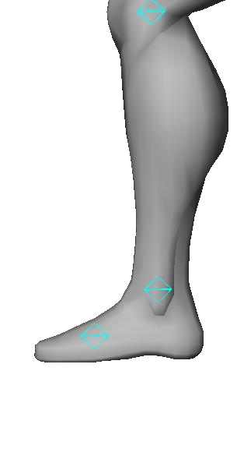
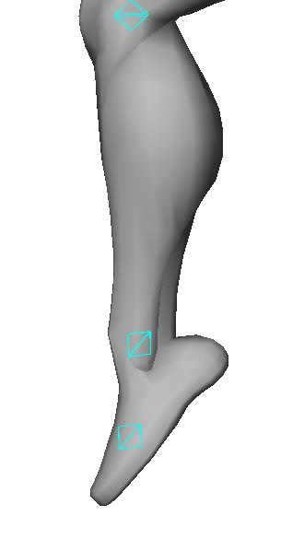
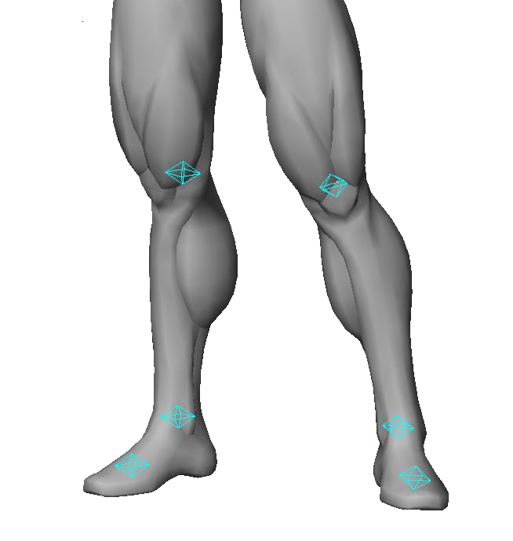
Common Mistake: High ankle axis position.
A common mistake I see is the placement of the ankle rotation axis. In a normal standing pose, it's hard to notice the mistake, and there are many cases that we will implement it as it is, regretfully, because we have already made the animation.
In a normal standing pose, it looks fine and is often overlooked. By the time you notice it, it's too late...

Slide 25
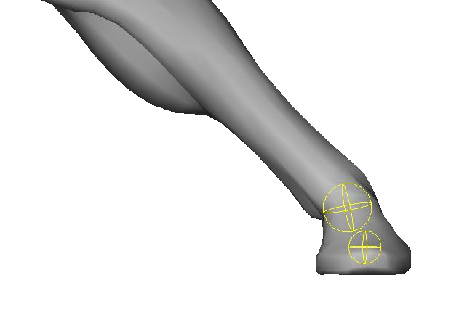
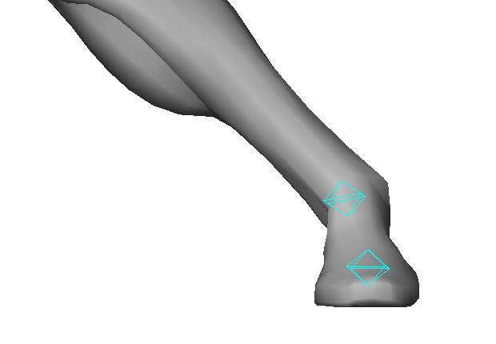
Importance of ankle placement
In the depiction of action, the ground contact around the feet is very important to make any behavior more convincing. In particular, the correct placement of the ankle joint is especially important for "stomping" movements, as the load on the ground surface is what makes them convincing.
If the position of the ankle joint is too high, the direction of force from the foot will go outside the base of your foot, when it is flat against the ground, giving the impression that the foot is about to sprain.
Shoes with high heels, for example, need to be very carefully posed.

Slide 26
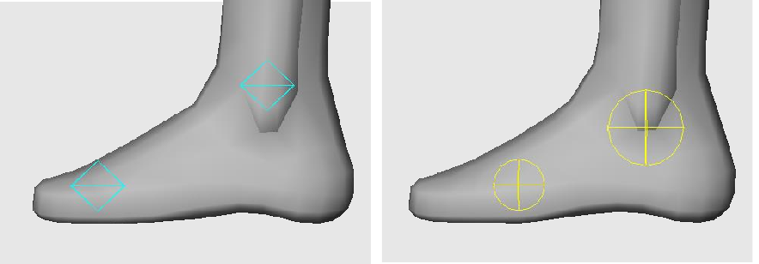
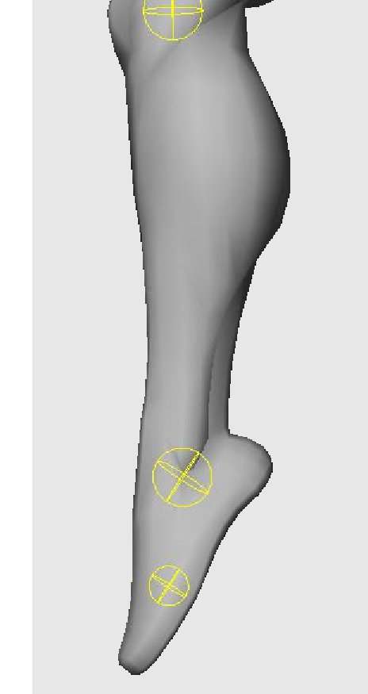
Guideline: Rotation axis placement of the ankle
⇒Approximate placement
A good rule of thumb for placing the bones is to keep the bottom of the ankles in mind.
If you are wearing shoes with heels, the thickness of the heel should also be taken into account when making adjustments.
When the toes are extended, the shin and the top of the foot should line up in a straight line to create a natural and beautiful shape in various poses.

Slide 27
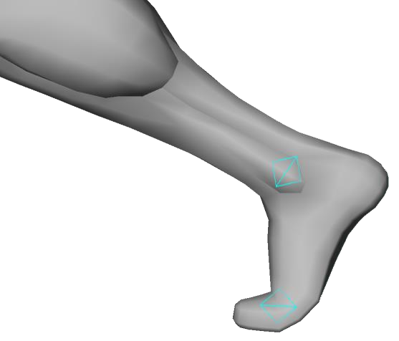
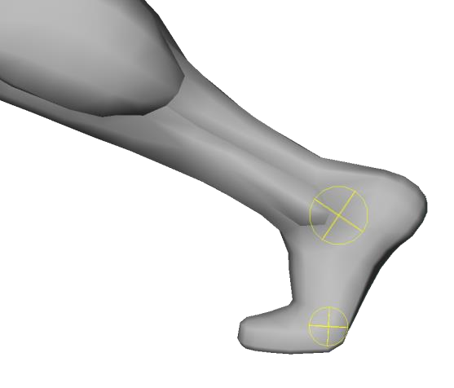
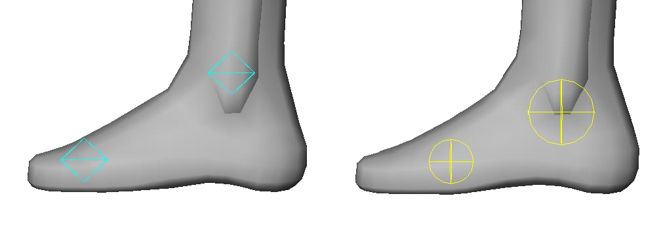
Guideline: Toe Bone Placement
The axis of rotation for moving the entire toe together with a single bone, assuming that the foot is wearing shoes.
The toe stomping pose is important in every action, including running.
If you remember that the length of the toe contact area is about 1/3 of the total foot length, it’ll work out alright.
(If you are barefoot, you can make it a little shorter.)
⇒Approximate placement
As mentioned above, if you place it around 1/3 of the entire foot you’ll have a good balance.
The height is right in the middle of the base of the toes.
For shoes with soles, the thickness of the sole should also be taken into account.

Slide 28
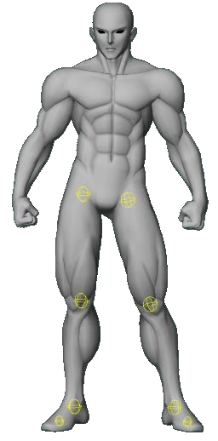
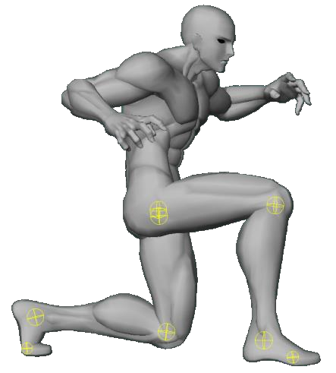
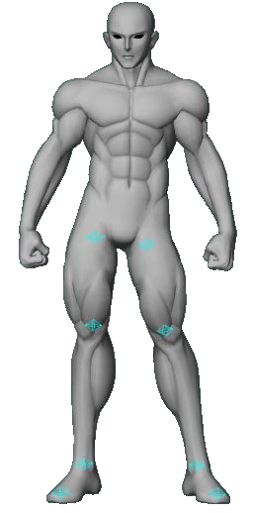
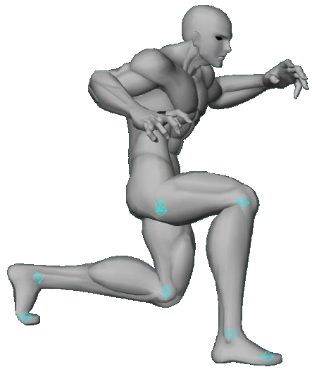
Common Mistake: The shins are too long.
Sometimes it is tempting to make the shins longer than the thighs, to make the figure look more stylish.
You have to be careful.
Essentially, the thigh is longer than the shin in the human body.
The femur is the longest bone in the human body.
If your shins are longer than your thighs, It’s difficult to make a kneel or wide and low stride, which are common poses in action scenes.
If you need to create a character with a long shin, you can use a rig that allows you to freely change the length of the thigh and shin, so that each pose is "picturesque”.
Even if in the same pose, when the ratio of the length of the thigh to the shin is different, you’ll see a huge difference, as shown on the image to the left. If the shin is too long, you can see that kneeling poses are not easy to achieve.

Slide 29
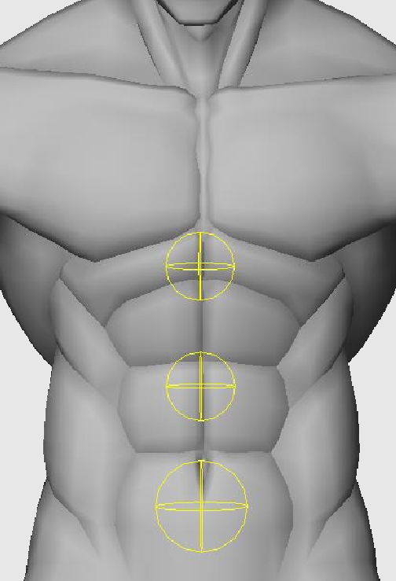
Torso

Slide 30

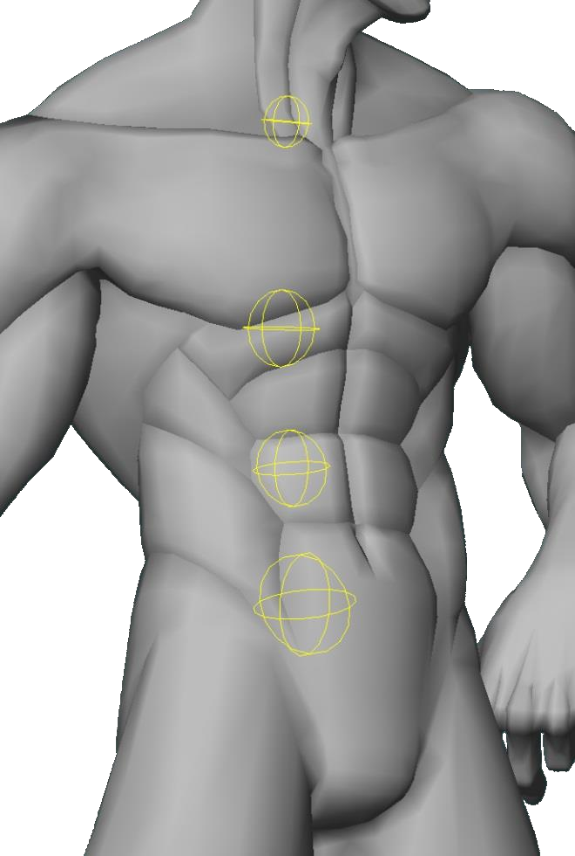
Bone placement in the torso
⇒The torso, also known as the trunk
This is the "trunk" of the human body, also known as the "core".
As the center of the human body, we can bend forward, backward, twist, tilt, etc.
It is the part that shows various expressions and supports the very core of the action.

Slide 31
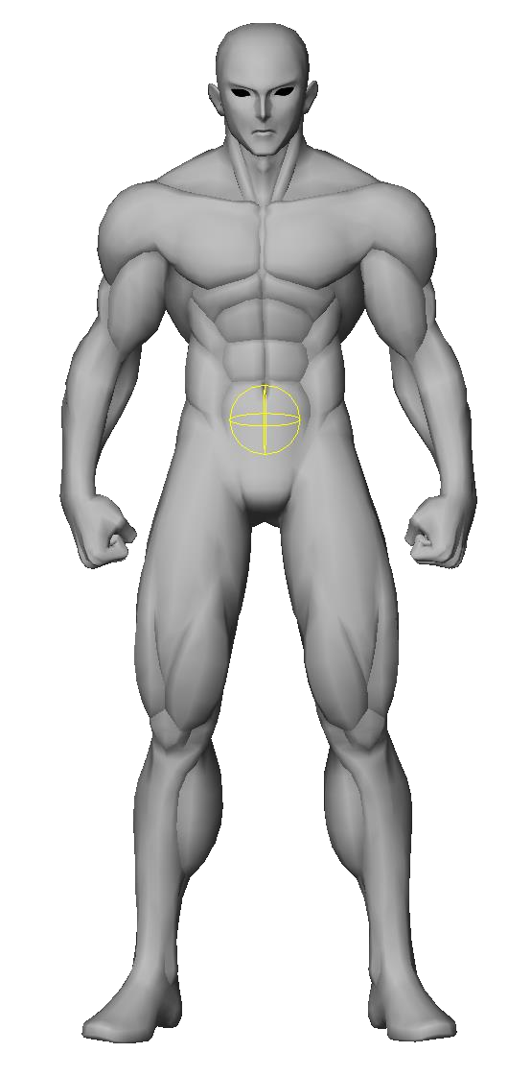
Position of the Center of Gravity
The center of gravity of the whole body should be placed in the "tanden" area.
Tanden is a term used in oriental medicine and martial arts to refer to the area three inches below the navel.
It is the center of gravity of the entire body. There are many theories, but it is a few centimeters below the navel.
This position is the approximate center of gravity of the entire body, including the weight of the head (which is surprisingly heavy!).
(Although it varies from person to person depending on the length of the legs, the amount of fat, muscle, etc.)
When animating, if you want to create a movement that rotates the whole body, the axis of rotation is much easier to create if it is placed at the center of gravity of the whole.
For this reason, it is best to place the root bone, which moves the entire body, at the "tanden" position.

Slide 32




The center of gravity should be able to be moved.
⇒The center of gravity of the whole body is not constant.
When performing acrobatic movements such as backflips and somersaults, the center of gravity of the whole body may move "outside the body" due to changes in posture.
If you have a "center of gravity” bone that can be moved, as a parent of the Tanden of the previous slide, it will be easier to make these actions.
In the pose shown on the left, if the character is rotated around the tanden, the rotation will look very unstable.
If such a movable center of gravity is not set, the animation adjustment process becomes much more difficult.
(TL Note.: While I believe it is clear what Junya meant here, I am unable to properly word it in technical terms. My apologies if it is unclear.)
Rotation Axis
Tanden

Slide 33

How many bones in the spine are appropriate?
⇒You want at least 3 spines.
How many bones are best to represent the area from the pelvis up, from the waist to the chest? There is no absolute answer to this question.
However, except in cases where you need to create a lot of characters for mobile devices, if you want to have a certain level of expressiveness, you probably want at least 3.
The reason is that with three of them, you can draw an "S-shape" or change the peak of the curve to some extent.
When the number of bones is 5 or more, it's hard to feel any noticeable benefits, while being more complex to skin, so 3-4 bones is actually reasonable.
With 2 bones, the range of expression is limited.
With 3 bones, a variety of expressions becomes possible.

Slide 34




Guideline: Spine placement (Height)
In most cases, Arc System Works uses the following three components for the spine.
Waist
Stomach
Chest
⇒Approximate placement
The guidelines for the placement of each of the 3 bones are as follows.
Waist: Height of the aforementioned tanden
Chest : Height of the midriff
  Stomach: Middle height of the above two

Slide 35

Why is the chest in a high position?
On the spine placement page, some of you may have felt that the Chest position is too high. There is a reason for that.
⇒An arrangement that dared to lie for the sake of expression
The high chest position is to create a nice curve when rounding the back.
This is not an attempt at anatomical correctness, but a deliberate exaggeration.
In fact, the ribs are not very bent, but for the purpose of expressing the action, I dare to lie and place the bones so that the silhouette changes greatly.

Slide 36





Guideline: Spine placement (depth)
As with the Chest height, it also lies a bit about the depth of the spine.
⇒Daring to lie for the sake of expression: Part 2
Since it is called "spine," the bones of the torso should be located in the back.
However, ArcSys dares to place the spine right in the middle of the thickness of the torso.
There are several reasons for this, but the main ones are to stabilize the results of the twisting deformation and to avoid changes in the length of the upper body when bending forward or backward.
If you place it too far back, it will shorten the body when bending forward.

Slide 37





Pelvis that can move independently.
⇒In games with kicking techniques, you want to move the pelvis independently.
Although some rig structures may not have bones that would move only the lower half of the body,
in fighting games, which use a lot of kicking and other techniques, you need to keep your upper body in place.
A bone that rotates only from the pelvis down is useful for pose adjustment.
In this case, the axis of rotation is between the spine and pelvis, so it’s just about at the same place as the aforementioned Tanden.
The position of the pelvic rotation axis should be almost the same as that of the tanden.
If you can rotate only from the pelvis down independently, it’s easy to adjust poses for kicking techniques, etc.

Slide 38

Upper Body

Slide 39

Bone Placement of the Upper Body
⇒The most obvious and therefore the most difficult.
The upper body of a character is the part of the body that is most likely to attract attention in any scene, not just in action. In addition to the face, the shoulders, arms, and hands are unavoidable parts of a character's expression.
Also, because we are used to seeing them in our daily lives, we can easily notice even the slightest discomfort.
It is also the part of the body where fine adjustments have great significance.
Bone placement is especially important for fingers and hands, where millimeters of adjustment can make a big difference in the impression.

Slide 40




About shoulder movement
⇒Don't underestimate the movement of the shoulders.
Shoulder movements are very important not only for actions but also for emotional expressions, such as "shrugging" and "dropping".
In action, whether or not you put your shoulders into a punch can completely change the strength and meaning of the pose. Depending on the posture of the shoulders, the pose may be "I put power into it" or "I hit it lightly”.

Slide 41


Common mistake: Small shoulder movement.
Shoulder posture is essential for acting out the power.
Therefore, if the range of movement of the shoulders is limited, the range of performance and the range of strength that can be expressed will also be extremely limited.
To increase movement, you need to increase the distance from the shoulder area you want to move to the center of the axis of rotation.
The smaller the radius of rotation, the more compact the movement.
The range of motion of the human body's shoulders is incredibly wide. Try moving your shoulders up and down, back and forth, and see for yourself.
Even if the pose has the exact same rotation value, the radius of rotation becomes narrower and the movement becomes stiffer depending on the position of the bones.

Slide 42

Guideline: Placement of clavicle bones
⇒Approximate placement
The actual shoulder of the human body consists of many bones such as the clavicle, scapula, and humerus, as well as muscles and tendons, which cannot be reproduced by a simple rotational movement of a single bone.
For most cases, in order to obtain the necessary expressive power while simplifying to some extent, the structure around the scapula on the back can be omitted, and the approximation should be based on the movement of the clavicle.
At ArcSys, the axis of rotation is positioned close to the center of the chest, similar to the actual clavicle, to get a large shoulder movement.

Slide 43



Common Mistake: misaligned shoulder joint.
？
？
Although not as extreme as the above figure, it is common to make a mistake in the placement of the rotation axis of the upper arm. Even with the same mesh, depending on the position of the rotation axis of the upper arm, the mesh may look different.
As shown in the figure above, the width of the shoulders changes when the arms are lowered, which can result in large gaps in the armpit area, or, inversely, the upper arm may be tucked into the torso.
This is a situation that should be avoided, although it is relatively easy to notice and is rarely left untreated.

Slide 44

Guideline: Placement of upper arm bones
⇒Approximate placement
When determining the axis of rotation of the upper arm bone, it is easier to arrive at the correct answer by calculating backward from the position of the armpit and the thickness of the arm.
The appropriate shoulder width is difficult to determine, since it varies from character to character. However, if you think about it based on the position of the armpits, you can find a general rule.
The resulting deformation should be "enough to hold a thermometer under the armpit" when the arm is lowered, and the inside of the torso and upper arm should be slightly sagging.
A character with well-developed vastus lateralis muscles will look more natural with a slight dip in the arms and torso.
It's hard to decide on a single placement, but it's a very important placement, so adjust it as many times as you can.
Calculate backwards based on the thickness of the arm and its position when lowered vertically.

Slide 45


Guideline: axis of rotation of forearm
Like knees, the elbows are joints that can only bend in one direction.
The example on the left is not anatomically correct at all, but it is the arrangement we use most often because it is less likely to cause excessive flexion and extension.
In fact, the anatomically correct position is a little closer to the outer elbow side, but this is a compromise measure to make the penetration of the inner elbow more noticeable.
⇒Approximate placement
The joint should be about 1cm-1.5cm below the tip of the elbow. By placing the joint lower than the elbow, you can get a better elbow spike when you bend the forearm.

Slide 46


Tip: How to handle elbows.
Note that, unlike the knee, which has a "knee plate," the elbow protuberance is entirely part of the forearm.
(Try bending and stretching your own elbow while touching it.)
Unless you’re aiming for some kind of intentional performance, it is more natural to set the weight so that the elbow protrusions move with the forearm almost 100% of the time.
Notice that when the elbow is bent deeply, the forearm side keeps a straight line while the back of the upper arm curves.

Slide 47


Common mistake: forearms are too long.
Similarly to the shins before, in some cases, the forearm is made longer than the upper arm because it looks more stylish.
It is not a problem when the arm is extended, but it becomes very unnatural when you make poses for everyday movements such as arms crossed, clapping or touching the face, so you need to be careful.
Even in action, if you want to hit a hook with force, if the forearm is too long, you can not make a pose well.
It is good to remember that in the human body, the forearm is equivalent to the upper arm, or slightly shorter.
Which one looks more powerful?

Slide 48


Common mistake: wrist rotation axis placement.
⇒Placement of the wrist is more difficult than it seems.
In fighting games, it’s common to have an attack such as "palm strike," where you strike your opponent with the palm of your hand.
In such cases, if the rotation axis of the wrist bone is not properly positioned, the direction of the forearm does not match the position of the base of the wrist (that is, the "palm bottom"), and the force does not seem to transfer well.
It is important to note that the base of the wrist, near the base of the thumb, is not an extension of the forearm, no matter how much you turn your wrist.
You can feel this by bending your wrist to see where the base of your thumb comes from.

Slide 49


Guideline: Rotation axis placement of the wrist
⇒Approximate placement
In order to position the bottom of the palm as an extension of the forearm, the axis of rotation of the wrist needs to be positioned much further to the palm than one would normally think.
When you place it just at the border between the wrist and the palm of the hand, you will be able to convincingly express the warp of the wrist.

Slide 50




About fingers
⇒The most difficult part of bone placement is the fingers.
The most difficult part of the bone placement is the placement of the fingers. There are several reasons for this.
→I'm used to seeing it, so it’s easy to see mistakes.
This is the part of the body that you probably see the most in your life. It is easy to notice even the slightest discomfort.
→The need to accommodate all the different hand expressions.
These aren’t just used for Rock Paper Scissors, but also in various forms to express different emotions.
→The number of joints is large, and overall balance is required.
A simple calculation of 5*3 shows at least 15 bones in one hand.
All of them need to be arranged in a satisfactory ratio.
→Precision is required simply due to how fine.
Compared to other parts of the body, the structure is more detailed and requires millimeter-scale adjustments.
That's why when the work is good, the improvement in the quality of the result is also remarkable.

Slide 51


Common Mistake: Fingers curling
⇒The slightest deviation can cause discomfort.
Because of the detail of the finger area, delicate bone placement is required. A shift of just a few millimeters can drastically change the shape of the finger and make it look different from what was originally intended.
In the example on the left, we only changed the position of the finger bone by about 5 to 7 mm, but the way the finger bends is completely different, as you can see.
Even with the same mesh, a few millimeters of difference in the bone rotation axis can change whether the finger joints bend sharply or curl up.

Slide 52


Guideline: Finger joint (Height)
If you want the joint to be sharp, place it near the knuckles.
If the deformations results in a softly bent finger joint, the axis of rotation is usually too far from the back of the finger.
If you touch your finger, you will see that the bone is much closer to the back than to the underside.
⇒Approximate placement
It is best to place them about 1/3 of the thickness of the finger from the back of the finger.

Slide 53










Guideline: Finger joint (at the base)
Finger Palm
⇒Approximate placement (at the base of the fingers)
The root joints of the fingers are not located at the apparent base of the fingers, but "in the palm".
Notice that when you bend your fingers from the base, you are bending your palm halfway. A good rule of thumb for placement is to think of it as directly below the knuckle of each finger.
Notice also that the base of the thumb starts near the border between the wrist and the palm.

Slide 54

Guideline: Finger length
Setting the finger length ratio is really challenging.
It's not easy to get it right the first time. There are individual and character differences, and the only way to get closer to the ideal is through trial and error.
If there is one guiding principle, it is that "being able to make a clean fist" is the touchstone of whether the ratio is appropriate or not.
⇒Approximate placement
While it's hard, here are a few hints:
→The index and ring fingers are roughly the same length. (The ring finger is slightly longer.)
→The middle finger is approximately one fingernail longer than the index finger.
→The little finger is approximately one joint shorter than the ring finger.
→The thumb and middle finger are roughly the same length (but the knuckle ratio is different).
→The bones of all fingers become shorter as they move from the base to the tip.

Slide 55




Guideline: Axis of neck rotation
The neck is a continuous structure of multiple cervical vertebrae, and cannot be expressed by the rotation of a single bone.
It is necessary to seek a form that is reasonably convincing and expressive, while simplifying to some extent.
For the same reason as the joints around the shoulders, the neck also needs to be deep at the base so that it can be moved from the root in order to make some wide movement.
The deeper the joint position, the more movement is possible.
⇒Approximate placement
It is a good idea to place the axis of rotation at a height near the base of the collarbone so that it can be moved from the base of the neck.
In terms of depth, it is best to aim for the middle of the front-to-back width of the torso, so that you can easily handle both forward and backward leaning.

Slide 56




Guideline: Head rotation axis
The head does not have a natural axis of rotation, but it is fixed on the cervical vertebrae, which are connected to the neck. When you turn your face, it is your neck that is rotating.
As with the neck, it would be too much work to reproduce the movement of all the many cervical vertebrae, so we look for approximations with a small number of bones.
In the method used at ArcSys, the movement of the many bones of the cervical spine is approximated by the two bones at the base of the neck and another just below the head, as shown on the previous page.
⇒Approximate placement
To move the head, the axis of rotation is placed near the first cervical vertebrae leading from the skull. The position of the axis of rotation is midway between the nose and mouth, slightly behind the ears.

Slide 57
Part３
Finding the right bone placement

Slide 58
Finding the right bone placement
Note: The guidelines presented here are not absolute.
This is just an example of what worked for us at ArcSys when making a fighting game.
Since we can't simulate the human body perfectly, we have to use exaggerations, omissions, and interpretations from time to time.
We have to discard the items according to our convenience and explore the best arrangement on a case-by-case basis.
If you want to get good results, don't just blindly follow some guidelines.
We need to find the best way to do this each time. It is the way we think that is important.
So how do you find the right bone placement? Here are a few tips.
⇒Don't make assumptions. — First, refer to materials such as anatomical drawings, photographs, and illustration techniques.
⇒Your own body is the best teacher. — Let's move our own joints and observe.
⇒Assume trial and error. — Very few things work out in one shot!
⇒Make sure there are no flaws by trying many poses. — If you find out later, it's too late!
⇒Try to remember the arrangement when it goes well. — Let's find our own rules of placement based on the positional relationship of neighbouring parts.

Slide 59
Lastly

Slide 60
Finally
Summary:
What good is a character model that can't strike the cool pose you want?
– Mesh – Skinning – Bone Placement
Only when all of these elements are in place can a character model reach its full potential.
Among them, bone placement is the very foundation of a character model. No matter how good the mesh shape is, no matter how well it is skinned, poor bone placement can ruin all of that.
Therefore, the final value of the character model will be greatly enhanced if you can accumulate know-how on bone placement and be able to place them appropriately.
Once you've mastered it and figured out the rules, you can continue to apply it to your character creation.
I hope this session was helpful to you in your understanding of bone placement.

Slide 61






Other GGXrd 3D Materials

Slide 62

Follow me on twitter.
If you appreciate this translation and wish to donate or something, here’s my paypal.
Other presentations will be linked here, as I finish translating them.

